Slide 1
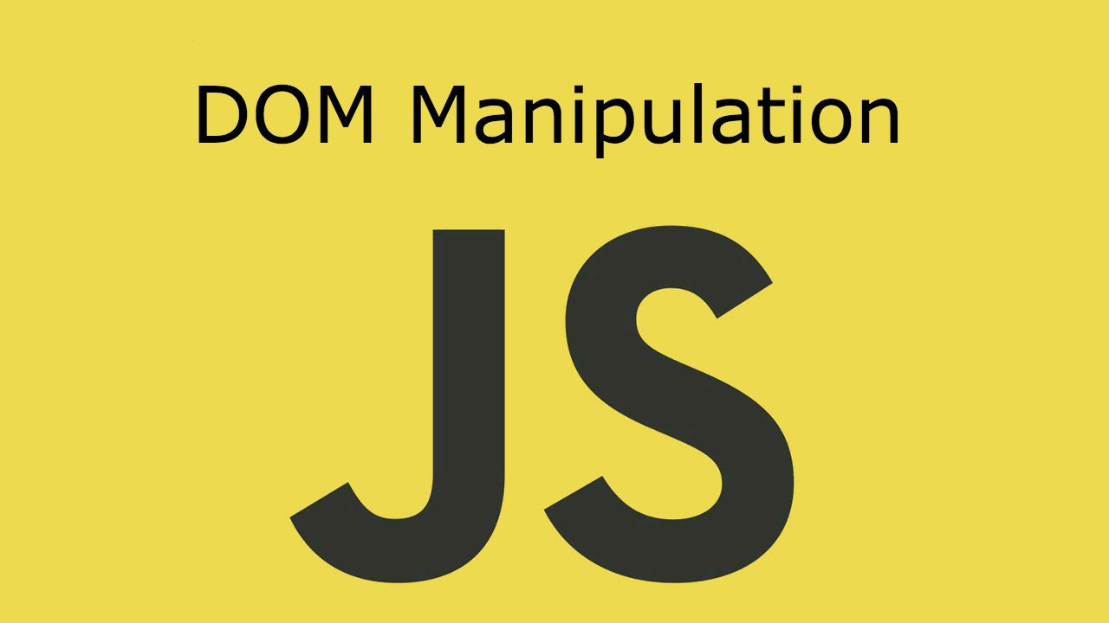
DOM Manipulations
Create / Delete DOM Elements, Handle Browser Events
SoftUni Team
Technical Trainers
Software University
http://softuni.bg

Slide 2
Table of Contents
Manipulating the DOM
Parents and Childs Elements
DOM Properties and HTML Attributes
Event Handling

Slide 3
Have a Question?
sli.do #JS-CORE

Slide 4


DOM Manipulations
Create / Delete DOM Elements

Slide 5
Creating DOM Elements
Creating a new DOM element
Create a copy / cloning DOM element
The above code creates a new elements. But these elements don't exist anywhere except as values inside variables.
Tag name
let p = document.createElement("p");
let li = document.createElement("li");
let li = document.getElementById("my-list");
let newLi = li.cloneNode(true);

Slide 6
Deleting DOM Elements
<div id="div1">
<p id="p1">This is a paragraph.</p>
<p id="p2">This is another paragraph.</p>
</div>
let parent = document.getElementById("div1"); let firstChild = document.getElementById("p1"); let secondChild = document.getElementById("p2");
firstChild.remove();
parent.removeChild(secondChild);
Directly deleting
Deleting by parent element

Slide 7
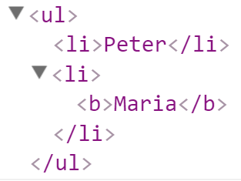
Creating DOM Elements
let list = document.createElement("ul");
let firstLi = document.createElement("li");
firstLi.textContent = "Peter";
list.appendChild(firstLi);
let secondLi = document.createElement("li");
secondLi.innerHTML = "<b>Maria</b>";
list.appendChild(secondLi);
document.body.appendChild(list);

Slide 8
Problem: Add / Delete
Write a program, which:
Creates items and append them into the list
Deletes items from that list

Slide 9
Solution: Add / Delete
function addItem() {
const input = document.getElementById('newText');
const itemsElement = document.getElementById('items')
const newLi = createElement('li', input.value + ' ');
const aEleAttribute = { name: 'href', value: '#' };
const aEleEventListener = { type: 'click', func: deleteItem };
const deleteLink = createElement('a', '[Delete]', aEleAttribute, aEleEventListener);
appendChilds(newLi,[deleteLink]);
appendChilds(itemsElement, [newLi]);
clearText(input);
// Continues on the next slide...

Slide 10
Solution: Add/Delete (2)
function deleteItem() { itemsElement.removeChild(this.parentNode); }
function createElement(tagElement, text, attr, eListener) {
const element = document.createElement(tagElement);
element.textContent = text;
if (attr) element.setAttribute(attr.name, attr.value);
if (eListener) element.addEventListener(eListener.type, eListener.func);
return element;
}
function clearText(element){ element.value = ''; }
function appendChilds(parent, childs){
childs.forEach((child) => parent.appendChild(child));
}
}

Slide 11
Problem: Delete From Table
Write a program, which:
Takes an e-mail from an input field
Deletes the matching row from that table
Shows notification

Slide 12
Solution: Delete From Table
function solve() {
const SELECTORS = {
TABLE_ROWS: '#customers tr td:last-child',
MESSAGE: 'result',
EMAIL: 'email',
};
const message = document.getElementById(SELECTORS.MESSAGE);
deleteByEmail();
function getEmail() {
return document.getElementsByName(SELECTORS.EMAIL)[0].value;
}
// Continues on the next slide...

Slide 13
Solution: Delete From Table
function deleteByEmail() {
const rows = document.querySelectorAll(SELECTORS.TABLE_ROWS);
const email = getEmail();
const rowToDelete = Array.from(rows).find(row => row.textContent == email);
if (rowToDelete) {
let row = rows[0].parentNode;
row.parentNode.removeChild(row);
message.textContent = "Deleted.";
} else {
message.textContent = "Not found.";
}
}
}

Slide 14

DOM Properties and HTML Attributes

Slide 15
DOM Properties
textContent - reads and writes text
innerHTML - returns and writes the HTML of a given element
value - gets and sets value
let text = Node.textContent;
Node.textContent = 'New text for element.';
let html = myElement.innerHTML;
myElement.innerHTML = 'New text for element.';
let theValue = theFormField.value;
theFormField.value = 'New value';

Slide 16
HTML Attributes and Methods
getAttribute() - returns the value of attributes of specified HTML element
<input type="text" name="username"/>
<input type="password" name="password"/>
const inputEle = document.getElementByTagName('input')[0];
inputEle.getAttribute('type'); // text
inputEle.getAttribute('name'); // username

Slide 17
HTML Attributes and Methods
setAttribute() - sets the value of an attribute on the specified HTML element
<input type="text" name="username"/>
<input type="password" name="password"/>
<input type="text" name="username"/>
<input type="password" />
const inputPassEle = document.getElementsByTagName('input')[1];
inputPassEle.setAttribute('name', 'password');

Slide 18
HTML Attributes and Methods
removeAttribute() - removes the attribute with the specified name from an HTML element
<input type="text" name="username" placeholder="Username..."/>
<input type="password" name="password"/>
<input type="text" name="username" placeholder="Username..."/>
<input type="password" name="password" placeholder="Password..."/>
const inputPassEle = document.getElementsByTagName('input')[1];
inputPassEle.removeAttribute('placeholder');

Slide 19
HTML Attributes and Methods
hasAttribute() - method returns true if the specified attribute exists, otherwise it returns false
<input type="text" name="username" placeholder="Username..."/>
<input type="password" name="password" id="password"/>
const passwordElement = document.getElementById(password');
passwordElement.hasAttribute('name'); // true
passwordElement.hasAttribute('placeholder'); // false

Slide 20
HTML Attributes and Methods
classList - is a read-only property that returns a collection of the class attributes of specified element
<div class="container div root"></div>
const element = document.getElementById('myDiv').classList;
// DOMTokenList(3) ["container", "div", "root", value: "container div root"]

Slide 21
HTML Attributes and Methods
classList Methods
add() - Adds the specified class values
remove() - Removes the specified class values
<div class="container div root testClass"></div>
<div class="div root testClass"></div>
<div class="container div root"></div>
document.getElementById('myDiv').classList.add('testClass');
document.getElementById('myDiv').classList.remove('container');

Slide 22

Parents and Child Elements

Slide 23
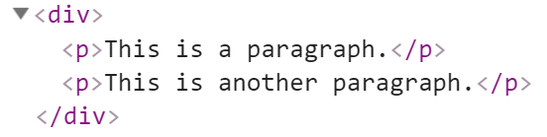

Parents and Child Elements
Every DOM Elements has an parent
Parents can be accessed by keywords .parent or .parentNode
Accessing the first child
let firstP = document.getElementsByTagName('p')[0];
console.log(firstP.parent);
Accessing the child parent

Slide 24
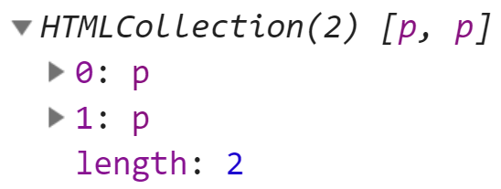
Parents and Child Elements
When some element contains other elements, that means he is parent of this elements
Also this elements is children to the parent. They can be accessed by keyword .children
Returns HTML Collection
let pElements = document.getElementsByTagName('div')[0].children;

Slide 25
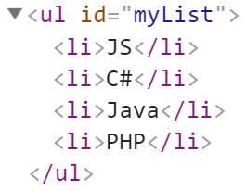
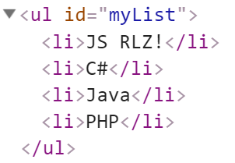

Parents and Child Elements
firstElementChild - Returns the first child node of an element
lastElementChild - Returns the last child node of an element
let list = document.getElementById('myList');
list.firstElementChild;
list.lastElementChild;
list.firstElementChild.textContent += " RLZ!";

Slide 26
Parents and Child Elements
nextElementSibling - Returns the next node at the same node tree level
previousElementSibling - Returns the previous node at the same node tree level
let ul = document.getElementById('myList');
let next = ul.children[0].nextElementSibling;
console.log(next.textContent); // C#
let prev = next.previousElementSibling;
console.log(prev.textContent); // JS

Slide 27
Parents and Child Elements
appendChild - Adds a new child, as the last child
prepend - Adds a new child, as the first child
let p = document.createElement("p");
let li = document.createElement("li");
li.appendChild(p);
let ul = document.getElementById("my-list");
let li = document.createElement("li");
ul.prepend(li);

Slide 28

Handling Events
Browser Events and DOM Events

Slide 29
Handling Events in JS
Browsers send events to notify the JS code of interesting things that have taken place
<div id='text'>Some text</div>
let div = document.getElementById('text');
div.onmouseover = function(event) {
event.target.style.border = "3px solid green";
}
div.onmouseout = function() {
this.style.border = ""; // this === event.target
}

Slide 30
Event Types in DOM API
Mouse events
Touch events
DOM / UI events
click
mouseover mouseout mousedown
mouseup
touchstart
touchend
touchmove
touchcancel
load
unload
resize
dragstart / drop
Keyboard events
Focus events
Form events
keydown
Keypress
keyup
input
change
submit
reset
focus (got focus)
blur (lost focus)

Slide 31
Attaching Click Event
const button = document.getElementsByTagName('button')[0];
button.addEventListener('click', clickMe);
function clickMe(e) {
const target = e.currentTarget;
const targetText = target.textContent;
target.textContent = (+targetText) + 1;
}

Slide 32
Attaching Hover Event
const button = document.getElementsByTagName(div')[0];
button.addEventListener('mouseover', function (e) {
const style = e.currentTarget;
const { backgroundColor } = style;
if(backgroundColor === 'white'){
targetStyles.backgroundColor = '#234465';
targetStyles.color = 'white';
} else {
targetStyles.backgroundColor = 'white';
targetStyles.color = '#234465';
}}
);

Slide 33
Attaching Input Event
const inputField = document.getElementsByTagName('input')[0];
const button = document.getElementsByTagName('button')[0];;
inputField.addEventListener('input', function () {
button.setAttribute('disabled', 'false')
});

Slide 34
Remove Events
const password = document.querySelector('input[type="password"]'); const button = document.querySelector('button');
password.addEventListener('focus', focusEvent);
function focusEvent (){ event.target.style.background = '#234465';}
password.addEventListener('blur', (event) => { event.target.style.background = '';});
button.addEventListener('click', () => { password.removeEventListener('focus', focusEvent);});

Slide 35
Multiple Events
The addEventListener() method also allows you to add many events to the same element, without overwriting existing events:
Note that you don't use the "on" prefix for the event use "click" instead of "onclick"
element.addEventListener("click", function);
element.addEventListener("click", myFunction);
element.addEventListener("mouseover", mySecondFunction);
element.addEventListener("mouseout", myThirdFunction);

Slide 36
Problem: Highlight Active
Write a function, which:
Highlights the currently active section of a document
Set the class of the div that contains the currently focused input field to "focus".

Slide 37
Solution: Highlight Active
function focus() {
let inputs = document.getElementsByTagName('input');
Array.from(inputs).forEach(i => i.addEventListener('focus', onFocus));
Array.from(inputs).forEach(i => i.addEventListener('blur', onBlur));
function onFocus(event) {
let input = event.target;
input.parentNode.setAttribute('class', 'focused');
}
function onBlur(event) {
let input = event.target;
input.parentNode.removeAttribute('class');
}
}

Slide 38
Exam problem: Dart Game
Write a program that simulates playing a Dart and keep tracking the players scores
Use the given index.html and app.js files to solve this problem

Slide 39

Live Exercises

Slide 40

Summary
Arrow functions ≈ short function syntax
Modifying DOM elements:
Handling events:
let menu = document.getElementById('menu');
menu.style.display = 'none';
menu.appendChild(
document.createElement('hr'));
let link = menu.children[0];
menu.removeChild(link);
let menu = document.getElementById('menu');
menu.onclick = function(event) { … }

Slide 41
https://softuni.bg/courses/js-advanced

Slide 42












SoftUni Diamond Partners

Slide 43




SoftUni Organizational Partners

Slide 44




Trainings @ Software University (SoftUni)
Software University – High-Quality Education and Employment Opportunities
softuni.bg
Software University Foundation
http://softuni.foundation/
Software University @ Facebook
facebook.com/SoftwareUniversity
Software University Forums
forum.softuni.bg

Slide 45

License
This course (slides, examples, demos, videos, homework, etc.) is licensed under the "Creative Commons Attribution-NonCommercial-ShareAlike 4.0 International" license

